Slide 1
National Clinical Audit and Patients Outcome Programme (NCAPOP)
Richard Arnold
Clinical Programme Lead, NHS England

Slide 2
Clinical Programmes Team
NICE Quality Standards and Clinical Guidelines
Clinical Audit (including the National Clinical Audit and Patient Outcomes Programme, NCAPOP)
Quality Accounts (Stakeholder)

Slide 3
The Quality Framework
Bring clarity to quality
Measure quality
Publish quality
Reward & recognise quality
Leadership for quality
Innovate for quality
Safeguard quality
NICE Quality Standards
NICE Clinical Guidelines
Indicators in NHS Outcomes Framework and CCG OIS
Clinical Audit
Indicators for Quality Improvement
Quality Accounts
NHS Choices and other sources of info for patients
Consultant Outcomes Data
Care.data
NHS England Patient safety website
Tariff
CQUIN
QOF
Standard contract
Quality premium
Clinical Excellence Awards
Boards
Responsible officers
Professional bodies’ leadership Clinical Senates
National Quality Board
Health & Wellbeing Boards
NHS Leadership Academy
Academic Health Science Centres
Academic Health Science Networks
NICE technology appraisals and compliance regime
NHS Improving Quality
Strategic Clinical Networks
CQC registration, monitoring and enforcement
Quality Surveillance Groups
Professional regulation
Monitor licensing

Slide 4
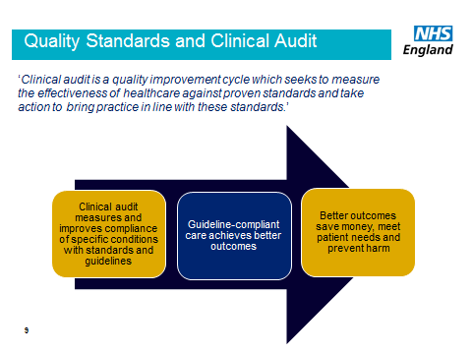

Slide 5
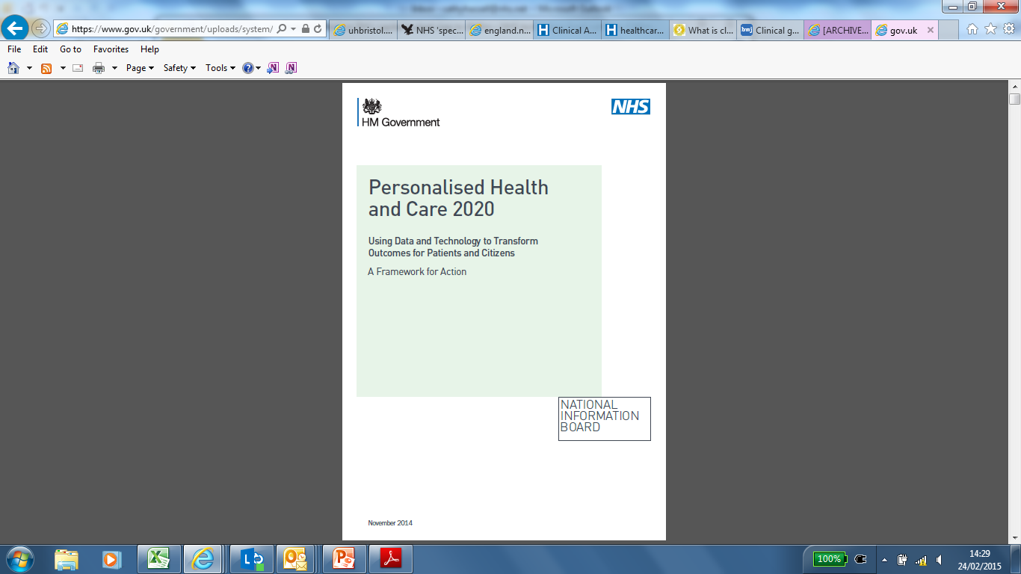

Policy Context
‘To reduce variations in patient care, we will publish meaningful and comparable measurements for all major pathways of care for every provider by 2020’
NHS Five Year Forward View, 2014
The National Information Board’s Framework for Action (2014) prioritises improvement of the quality and coverage of clinical audit across care services

Slide 6
National clinical audit
Understand Quality of Care
NCAPOP uses
Research-ers
Service Users
NICE
Health-care regulators
Comm-issioners
NHS England, DH
Health-care providers

Slide 7
Why impact is important and for who?
NHS England has a real desire to place clinical audit at the heart of quality improvement
Has high level support from the top of NHS England
Biggest single financial investment by NHS England Medical directorate
An ambition to improve the overall impact (outcomes) audits can have
Who: Local, National and from a patient perspective

Slide 8
Support on going improvement in the quality and impact of NCA’s
Audit design and execution – clarity of questions, clearly identified evidenced standards, frame the opportunity, buy in from stakeholders
Engagement and understanding – communication, clear communication of results and outputs to all stakeholders, clear exec summaries, user driven design, infographics, contextualise findings,
Patient engagement and understanding - appropriate communication, reporting on needs and interest of groups, developing key messages
Local adoption and implementation – ‘Sell the benefits’, what's important to stakeholders – clinicians, boards and the public is highlighted throughout, ensure relevance, communications plans including press release etc.
Evaluation of impact – communicate objectives, make commissioners more aware, are the right results being published?

